Slide 1
Dos Lagos
Health & Wellness
Master Plan Amendment
PUBLIC MEETING
City of Anthony, NM
December 12, 2022

Slide 2
Acknowledgements
Steering Committee Members, Board of Trustees & City Staff with the City of Anthony, NM
City of Anthony, NM
Mayor Diana Murillo-Trujillo
Mayor Pro-Tem Flores
Board of Trustees
City Manager, Mario Juarez-Infante
Projects Coordinator, Gloria Ramirez
Chief of Police, Moises Ruiz
Court Facilities Manager, Reinaldo Gutierrez
Memorial Medical Center
Chief Executive Officer, John Harris
Chief Operating Officer, Mary Armijo
Associate Administrator Justin LeMoine
Sr. Director Physician Services, Chris Lugo
Dona Ana Community College
Nursing Program Director, Cynthia Olivas
Program Director, Sharon Lashley
Gadsen ISD
Chief Academic Officer, Maria Hernandez

Slide 3
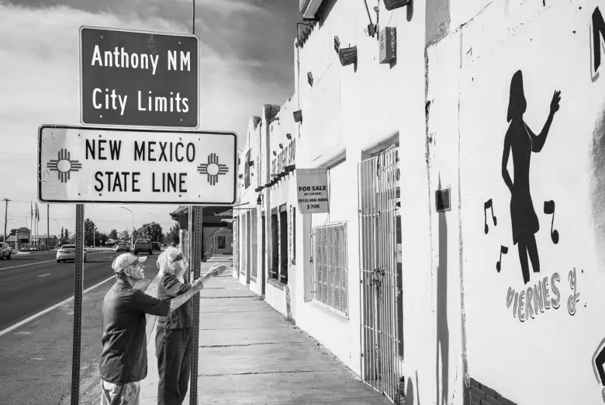
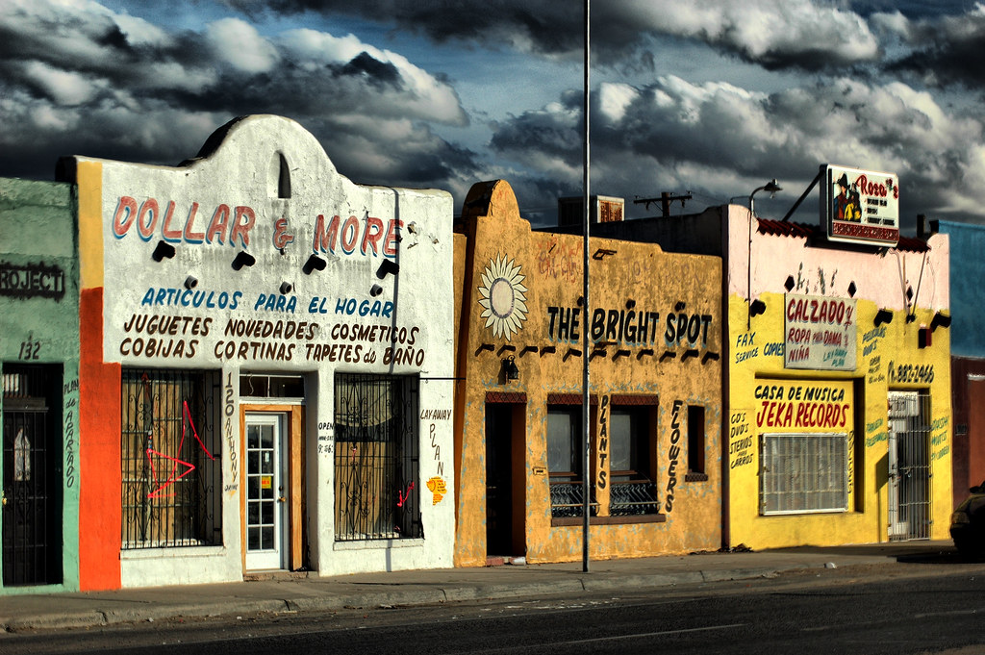
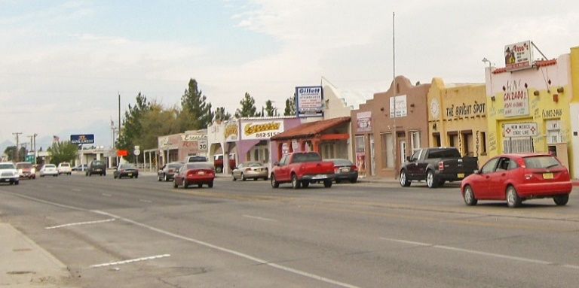
INTRODUCTION
Dos Lagos Master
Plan Amendment
Setting the Stage
City of Anthony, NM

Slide 4
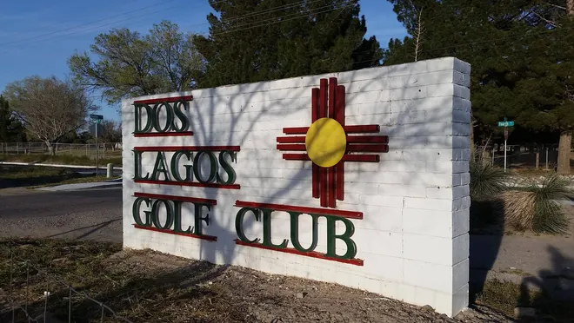
INTRODUCTION
Dos Lagos Master
Plan Amendment
Setting the Stage
Dos Lagos Golf Club

Slide 5
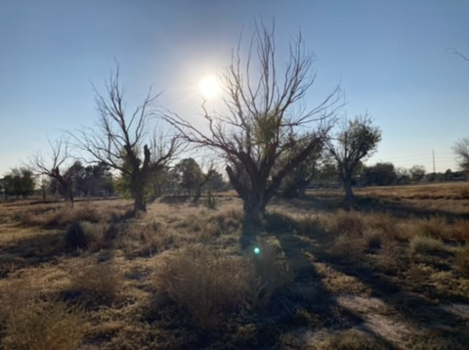
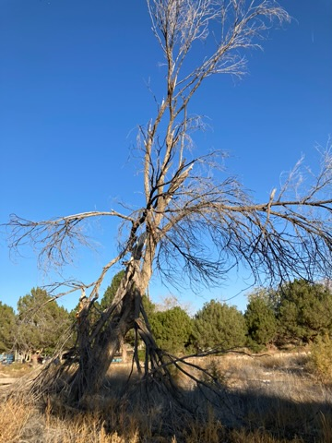
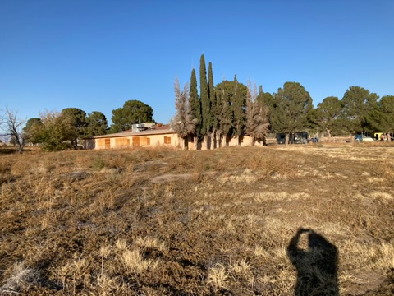
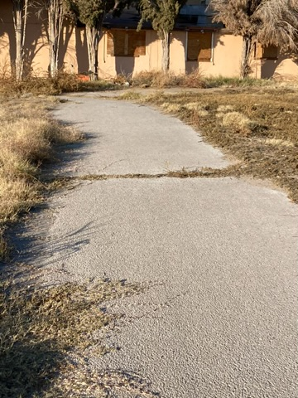
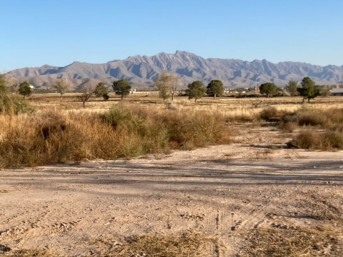
INTRODUCTION
Dos Lagos Master
Plan Amendment
Setting the Stage
Current Site Conditions

Slide 6


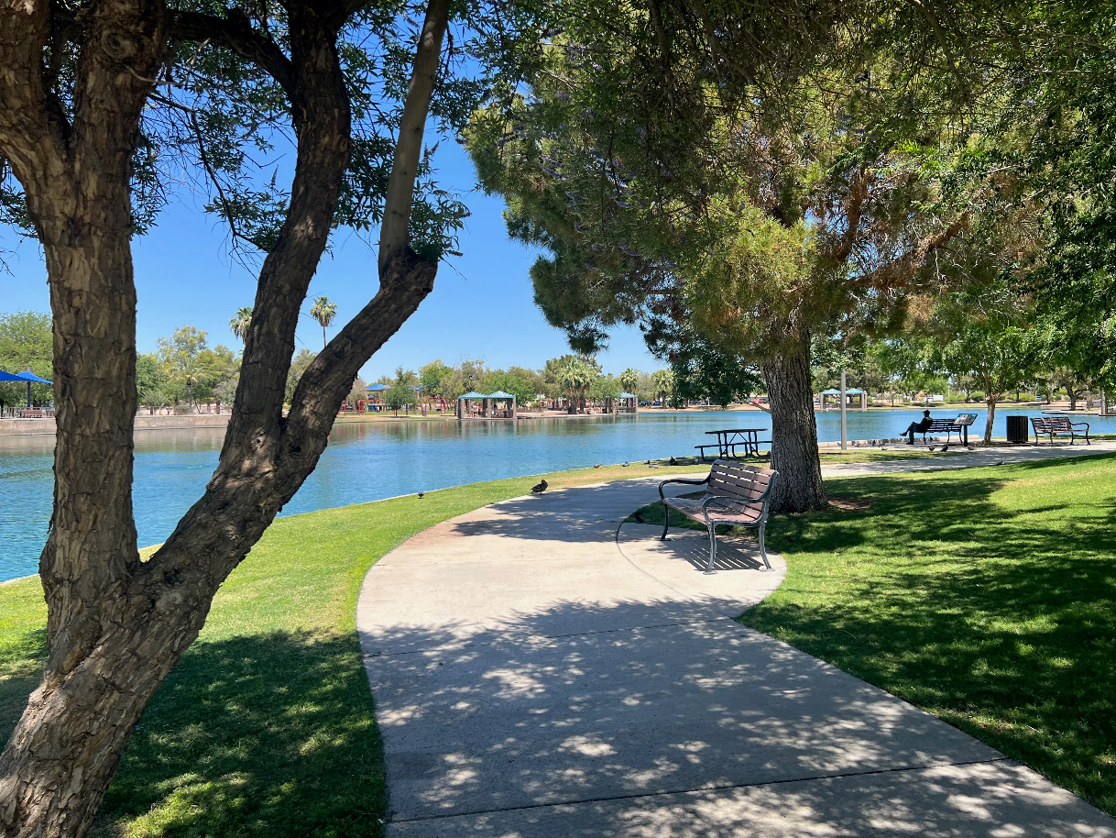
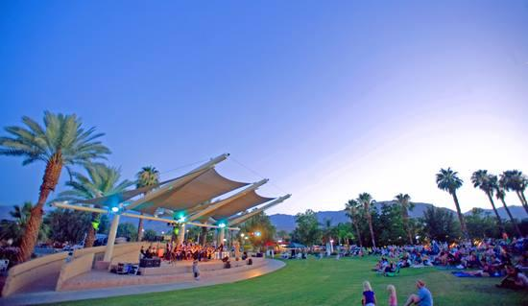
INTRODUCTION
Dos Lagos Master
Plan Amendment
Setting the Stage
Healing and Rejuvenation
Multigeneration Activities, Family & Exercise
Leisure and Recreation
Trees, Landscaping, Water & Trails
Culture, Entertainment & Relaxation

Slide 7
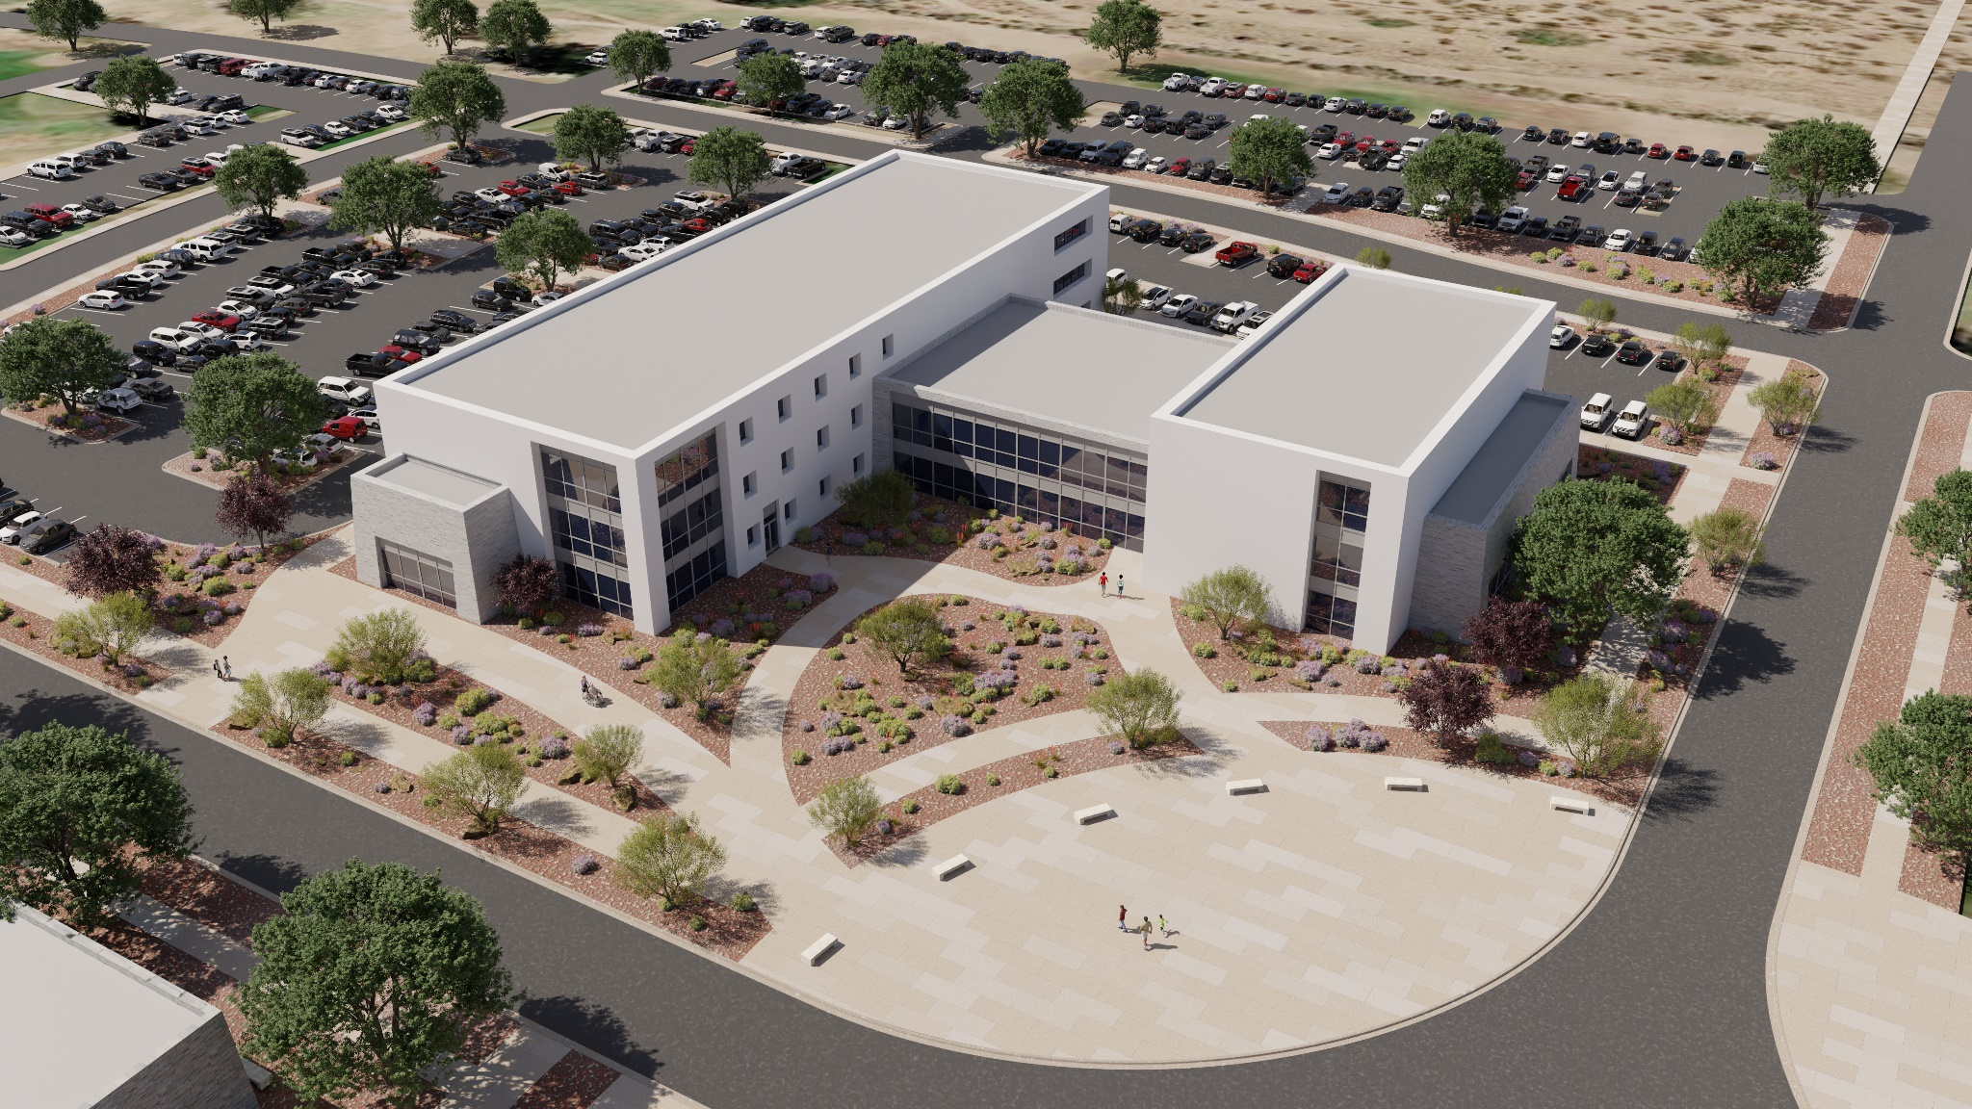
INTRODUCTION
Dos Lagos Master
Plan Amendment
Setting the Stage
Medical & Education

Slide 8
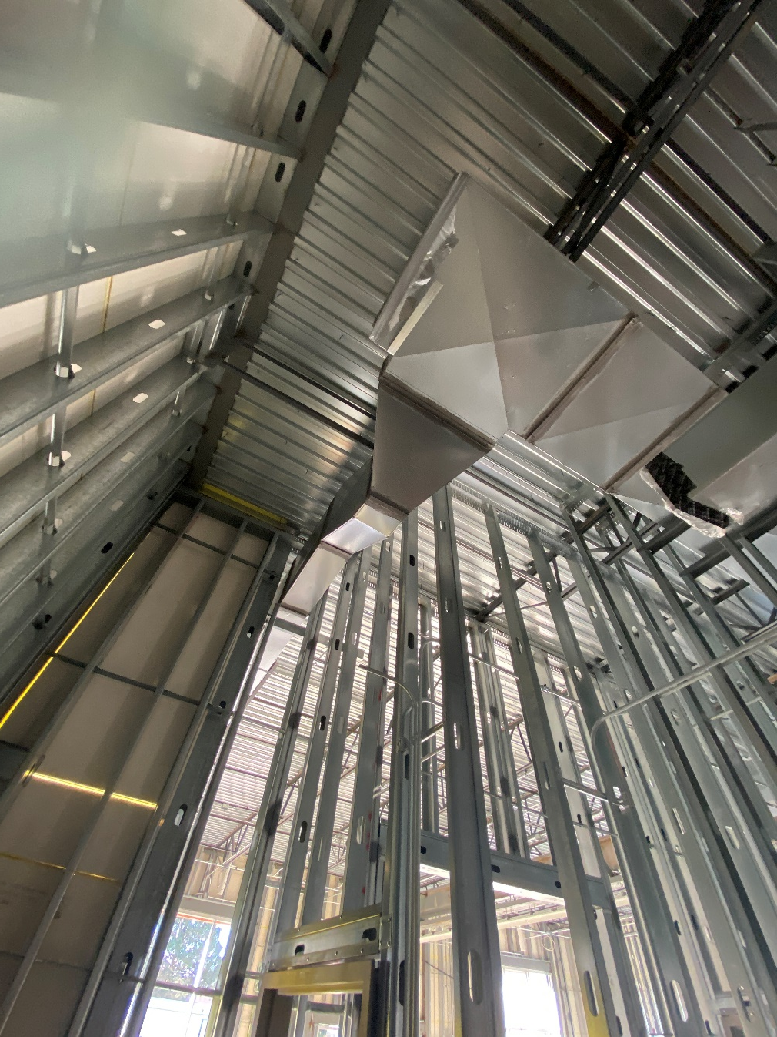
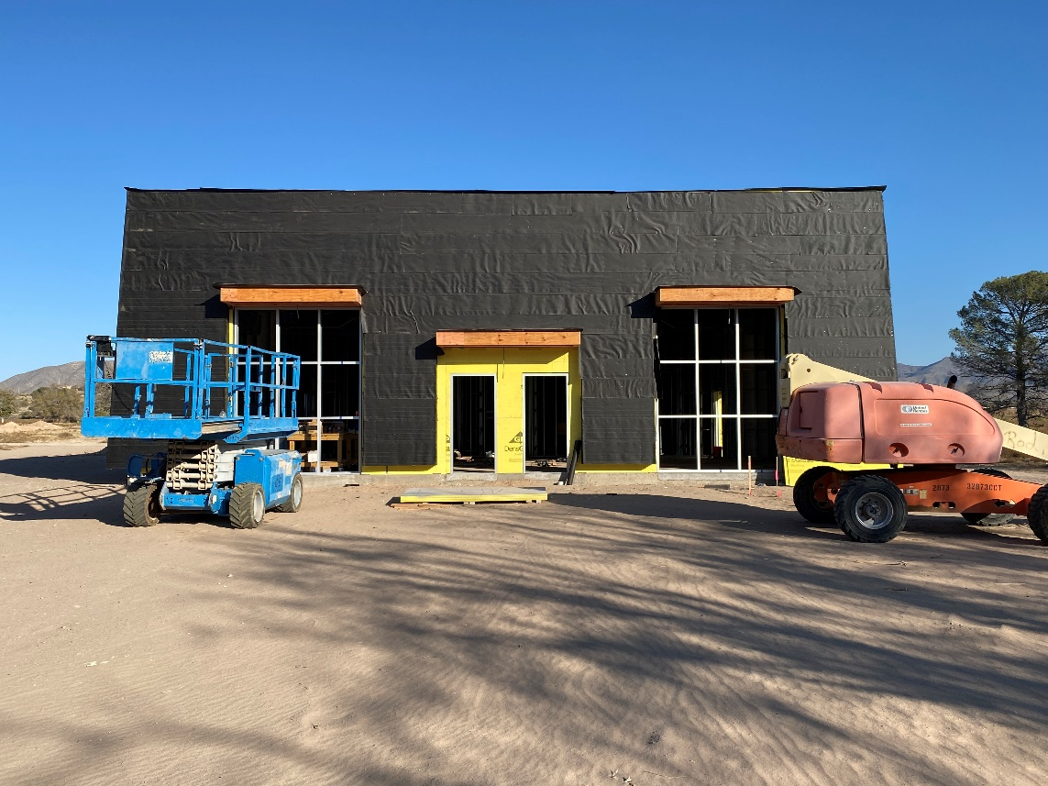
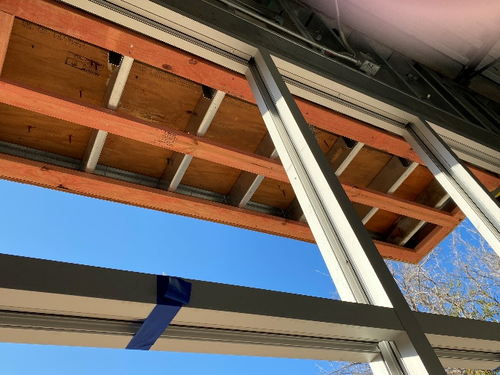
INTRODUCTION
Dos Lagos Master
Plan Amendment
Setting the Stage
Phase I – Multigenerational Community Center

Slide 9
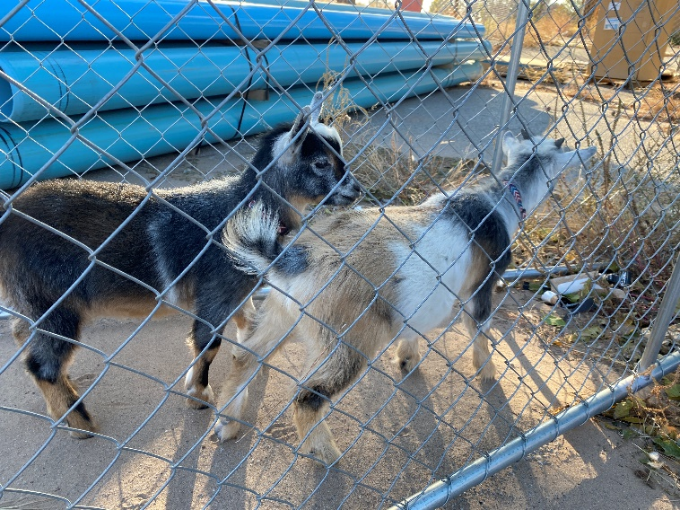
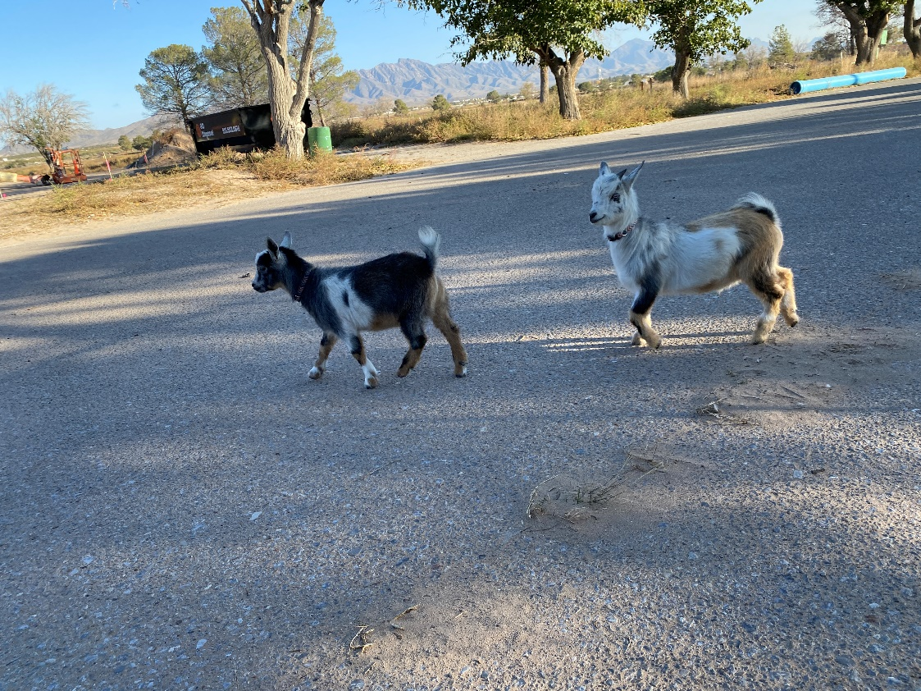
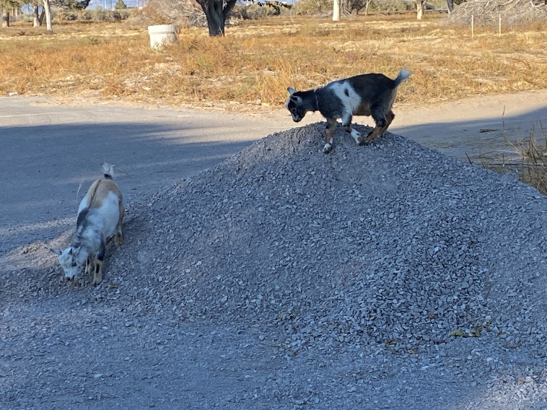
INTRODUCTION
Dos Lagos Master
Plan Amendment
Setting the Stage
Local Residents

Slide 10
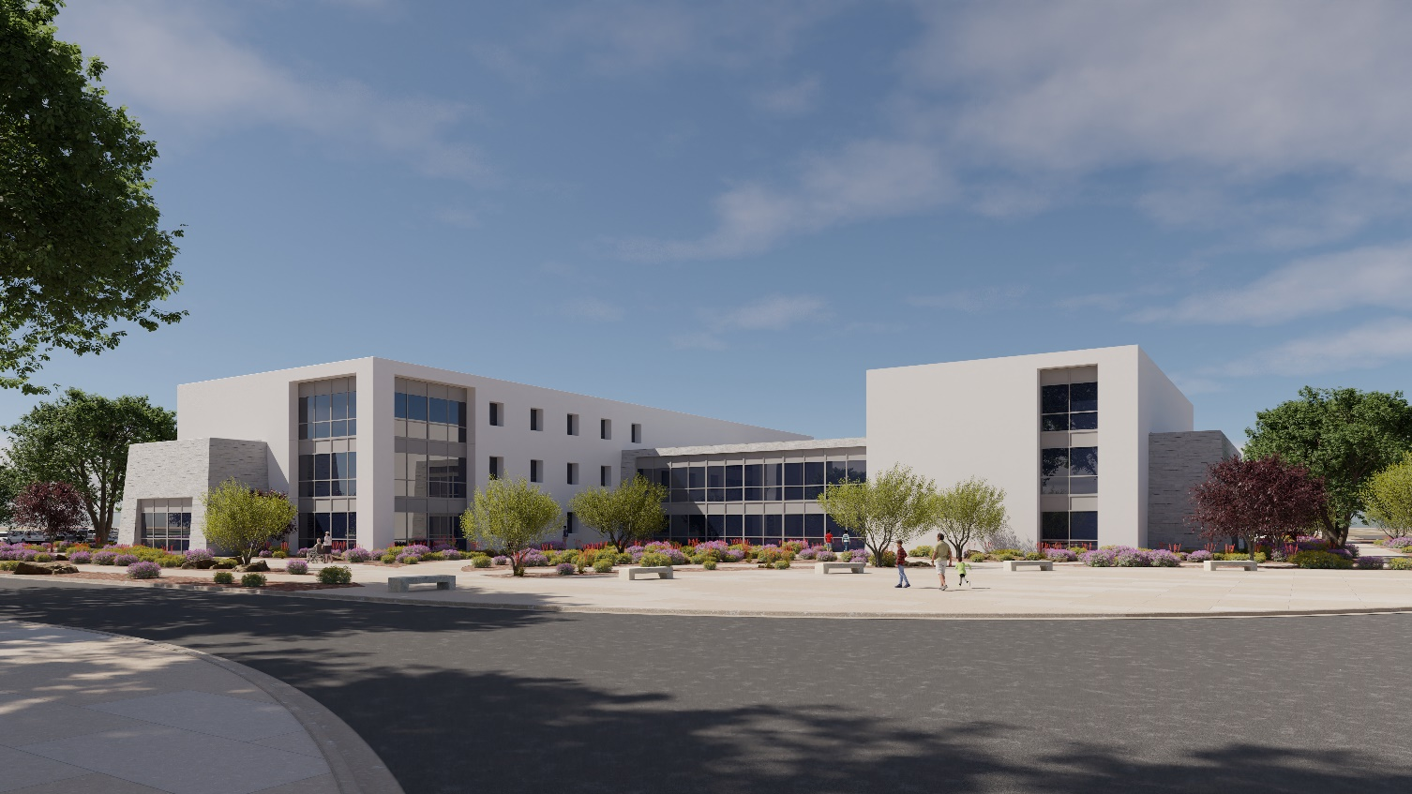
INTRODUCTION
Dos Lagos Master
Plan Amendment
Agenda
Introduction (6:00 – 6:15)
Master Plan Presentation (6:15 – 6:45)
  Background
    Efforts Past & Present
    Vision, Purpose, and Goals
  Planning & Programming
    Site Planning
    Programming
    Infrastructure
Open Public Discussion (6:45 -7:25)
Conclusion (7:25-7:30)
  Future Planning Efforts
  Meeting Adjournment

Slide 11
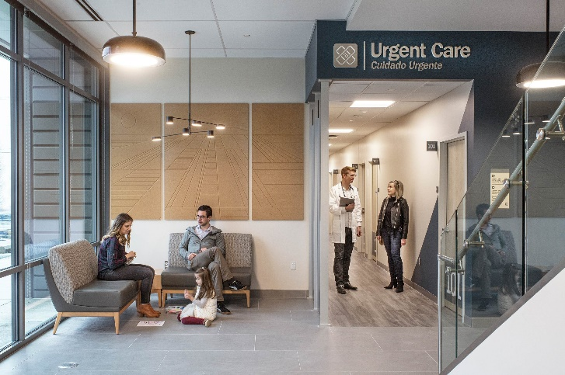
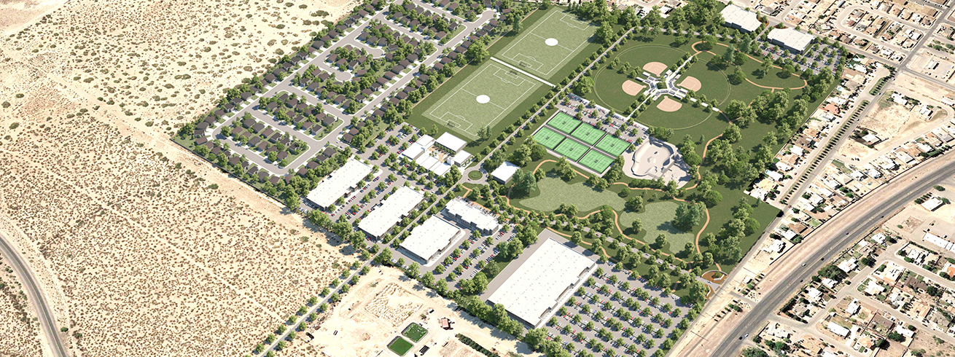
INTRODUCTION
Dos Lagos Master
Plan Amendment
Efforts – Past
    2018 – Clubhouse Feasibility study conducted
    2019 - Golf Course closes & City acquires site
    2020 - Public Involvement Plan and Initial Master Plan – Recreation/Comercial
    2021 - Additional funding acquired & Urgent Care Design

Slide 12
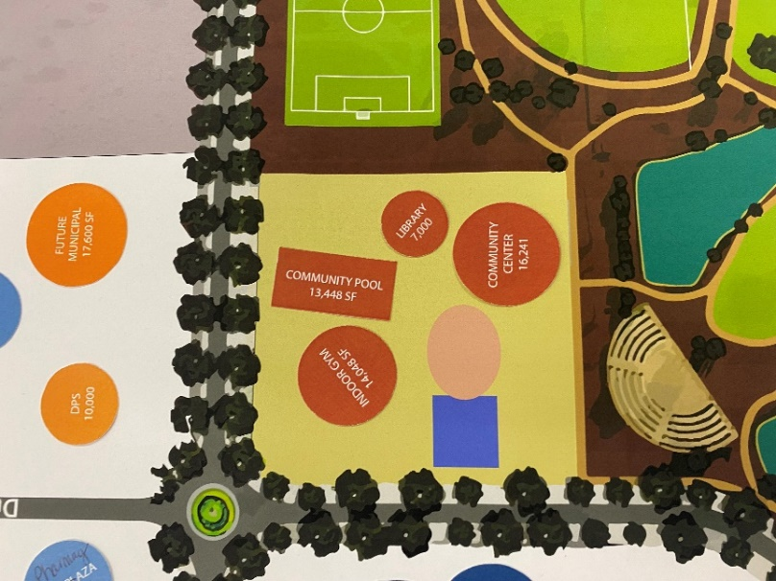
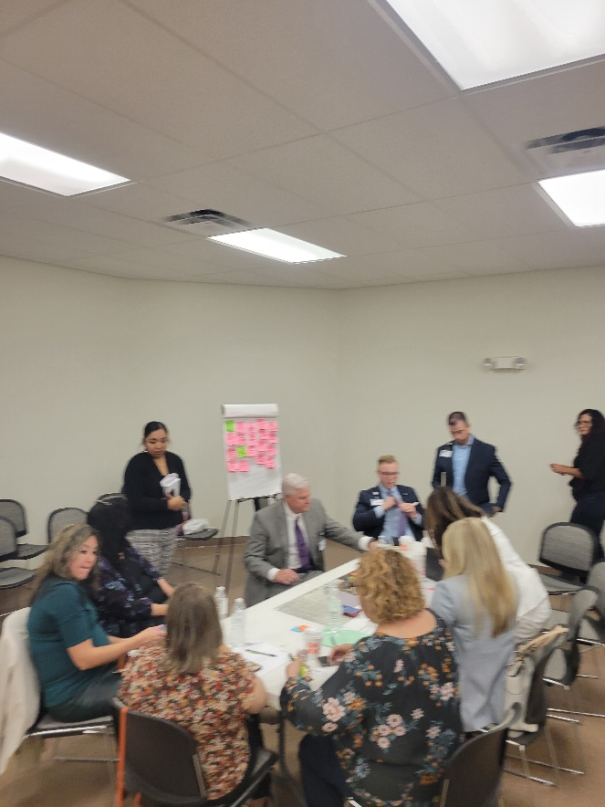
MASTER PLANNING PRESENTATION
Dos Lagos Master
Plan Amendment
Efforts - Present
2022
June 10, 2022
WCI Proposal - Professional architectural and engineering services
New focus on Health & Wellness
Teaching Clinic
July 6, 2022
Board of Trustees Votes to issue RFP for Medical Provider
Memorial Medical Center Selected
August 2022 & September 2022
Steering Committee - Clinicians, Educators, Professionals
  Memorial Medical Center Executive leadership team
  Dona Ana Community Colleges, Health Sciences Division
  Gadsen ISD Early College Medical Sciences program
Programming meetings and focus sessions
Collect valuable information

Slide 13


MASTER PLANNING PRESENTATION
Dos Lagos Master
Plan Amendment
Vision & Purpose
VISION
Break socioeconomic cycles - Slogan: "Everybody is somebody in New Mexico" (1975)
PURPOSE
Keep New Mexicans in New Mexico. What starts in New Mexico – Stays in New Mexico
Build on each other through education knowing that more can be done together

Slide 14
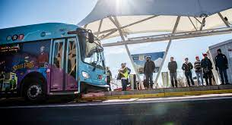

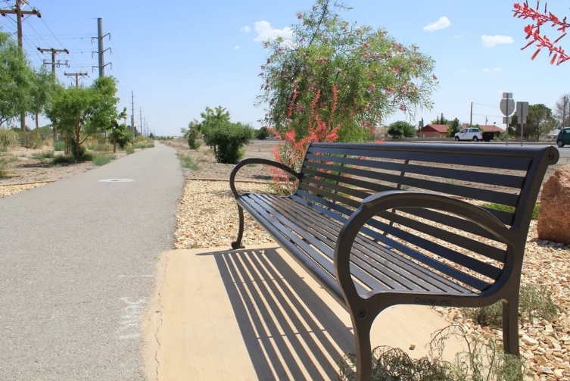
MASTER PLANNING PRESENTATION
Dos Lagos Master
Plan Amendment
Overall Goals
ECONOMIC GOALS
      Development – Provide New Jobs & Services
      Higher Paying Jobs
      Retain Residents & Jobs
        Educational Opportunities
        Higher-End and Specialized Services
        Local Career-Path Education
TRANSPORTATION GOALS
    Ease of Access
      Wayfinding, esp. to services & clinics
      Bike & Pedestrian Friendly
      City Trails Connections
      Ample Parking
      Frequent Bus Stops
      Transportation to and from Site
      Site Visibility
      Branding & Cohesive Design throughout site

Slide 15
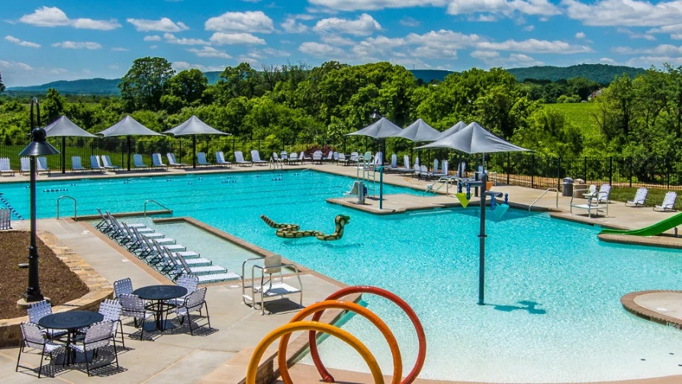
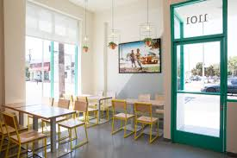
MASTER PLANNING PRESENTATION
Dos Lagos Master
Plan Amendment
Overall Goals
MASTER PLAN GOALS
HEALTH & WELLNESS AMENDMENTS TO CURRENT MASTER PLAN
Legend: Current Additions Revised or Relocated
Medical and Education District (Public/Private)
  Outpatient Teaching Hospital
  Future Ancillary Medical
  Pharmacy (Walgreens or CVS)
  Urgent Care Center
Commercial District (Public/Private)
  Future Small Restaurant & Retail
  Future Grocery Store
  Future Small Healthy Convenience Food
Municipal District (Public)
  City Hall
  Department of Public Safety (Located within courthouse building)
  AOC Magistrate Court (Moved from Multigeneration District)
Multigenerational District (Public)
  Community Center
  Gymnasium
  Outdoor Recreation
  Swimming & Therapeutic Pool

Slide 16
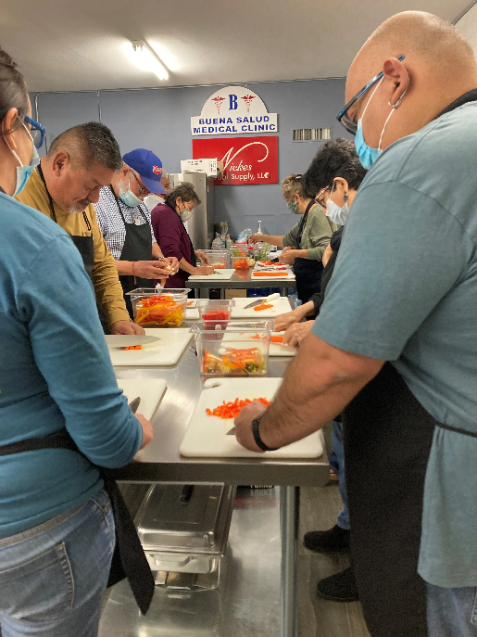



MASTER PLANNING PRESENTATION
Dos Lagos Master
Plan Amendment
Goals by District
MULTIGENERATIONAL DISTRICT
        Body, Mind, Spirit, People, Culture and Environment
        Support community
        Complimentary and Support services to Medical
        Family Services and Programs
        Social and Cultural Events
        Entertainment & Dining
        Fitness and Recreation
        Educational Facilities
          Arts Instruction
          Workforce Training
          Continuing Education

Slide 17



MASTER PLANNING PRESENTATION
Dos Lagos Master
Plan Amendment
BACKGROUND – Goals by District
MULTIGENERATIONAL DISTRICT ….Cont.
Mind, Body & Soul

Slide 18
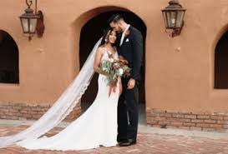
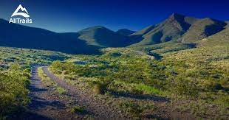
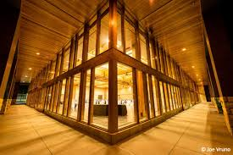
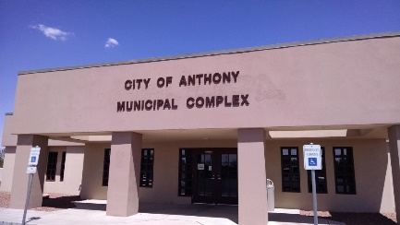

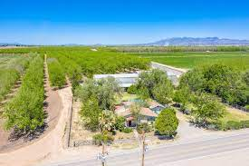
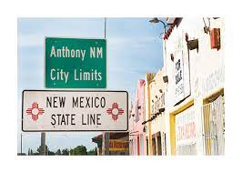
MASTER PLANNING PRESENTATION
Dos Lagos Master
Plan Amendment
BACKGROUND – Goals by District
MUNICIPAL DISTRICT
        Diversified, long-term employment opportunities
        Bring in public services as anchor tenants
        Gives City opportunity to secure public funds for infrastructure
        Rezone and sub-divided remaining real estate for commercial, retail, and housing
        Upfront development costs reduced making Dos Lagos attractive investment.
        Provide convenience to community by grouping many services in one area
        Move City Hall to prominent intersection
        Provides sense of place and presence
        Creates sense that you know you are in Anthony

Slide 19
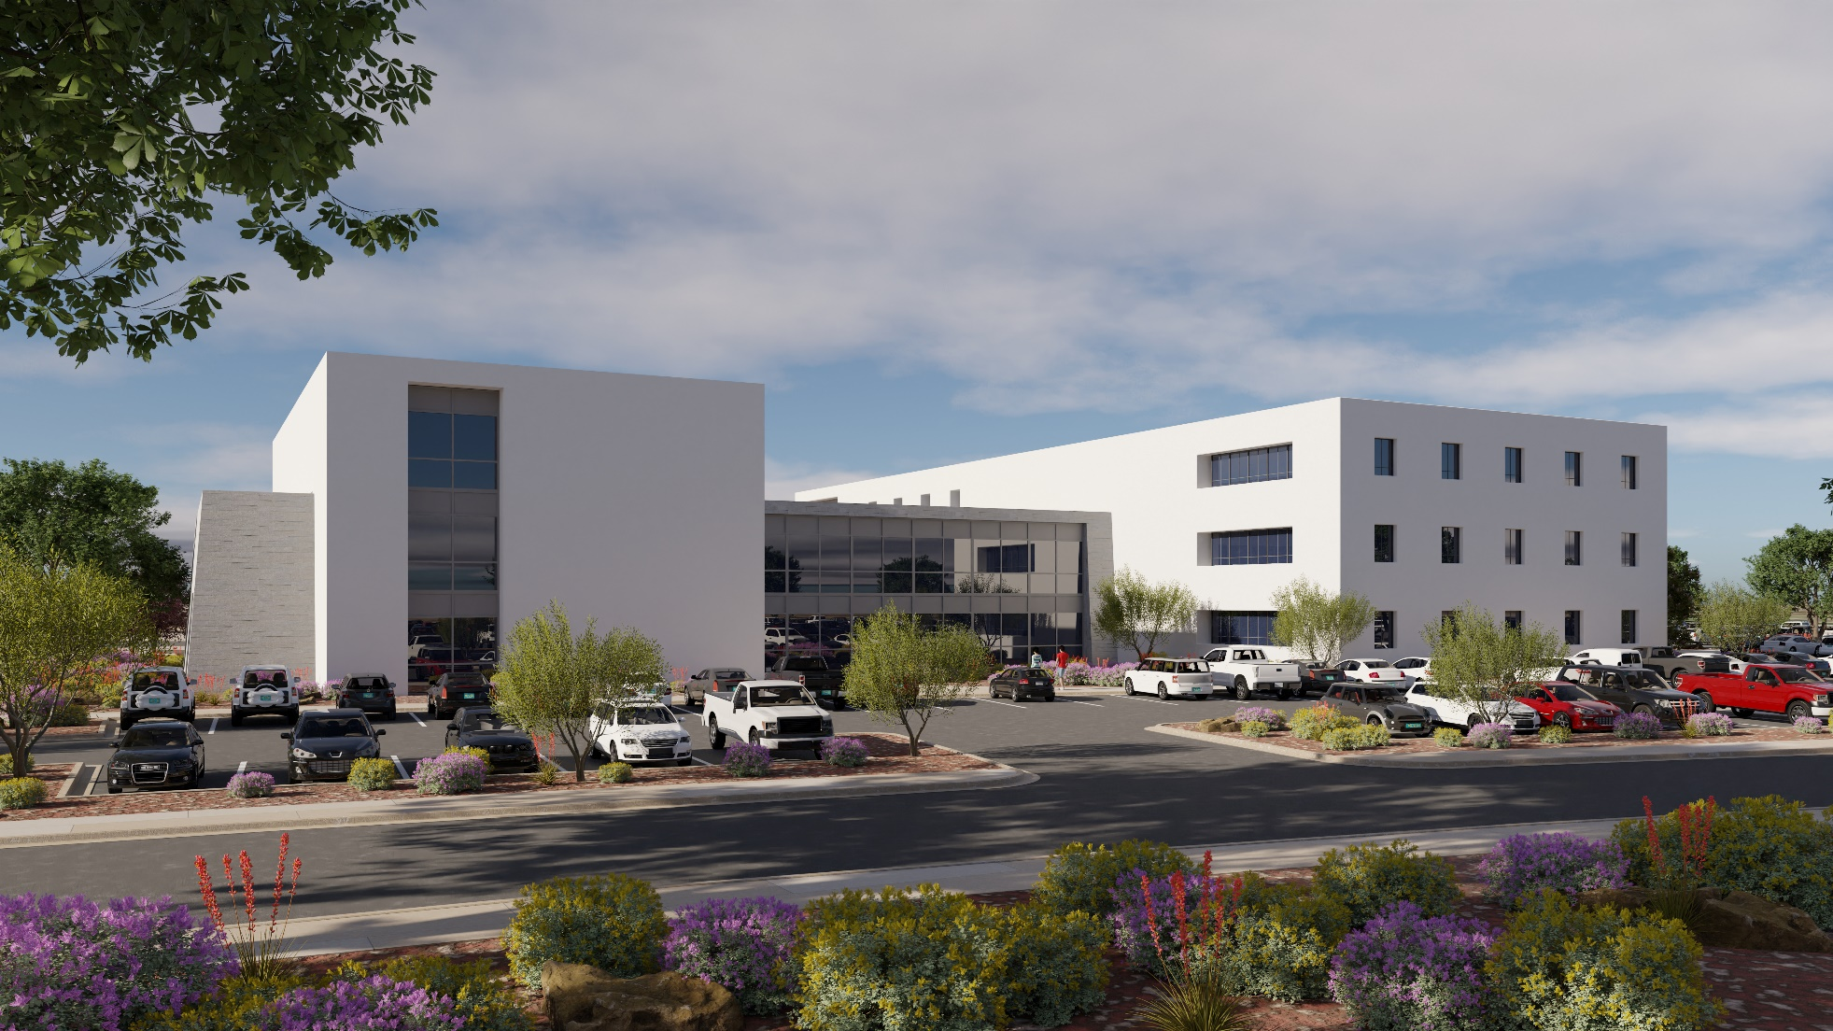
MASTER PLANNING PRESENTATION
Dos Lagos Master
Plan Amendment
BACKGROUND – Goals by District
        To have a presence in Anthony, NM and grow that presence
        Provide convenient, local, and comprehensive care for the region
        50K-70K SF of Specialty Clinics & Education under one roof
        Provide primary and secondary care in the region to help reduce strain on regional hospitals
        Address lack of medical services in the area - Especially the Diabetes epidemic
        Focus on Highly Specialized Services missing in area
        Provide clinical opportunities for students & pair with medical clinics for teaching opportunities
        Enable students to work in field and have more hands-on practice and experience
        Grow the number of students in attendance
        Attract more students to the area
        Provide flexibility and room for expansion –
        Medical and education
        Future, highly specialized services
        Exterior landscaped spaces & Biophilic interiors
        Focus on Wellness and Preventative Care
        Holistic, Traditional & Cultural Medicine
        Body, Mind, Spirit, People, Culture & Environment
        Nutritional and wellness programs
        Contemporary facilities and services that focus on current trends in healthcare, ease of use and comfort
        Convenience spaces for employees, students, and visitors to reduce stress
MEDICAL & EDUCATION DISTRICT

Slide 20
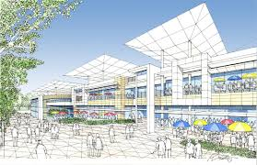
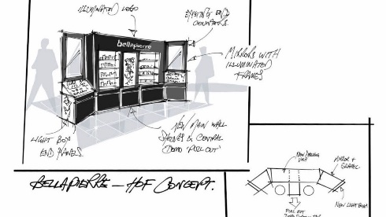
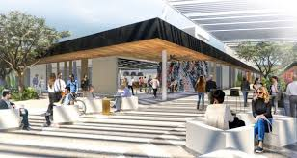

MASTER PLANNING PRESENTATION
Dos Lagos Master
Plan Amendment
BACKGROUND – Goals by District
COMMERCIAL DISTRICT
        Provide quick and easy services and conveniences to other districts
          Drycleaning
          Pharmacy
          ATM/Banking
          Nutritious Food
          Coffee Shop
          Gift Shops
          Postal Services

Slide 21
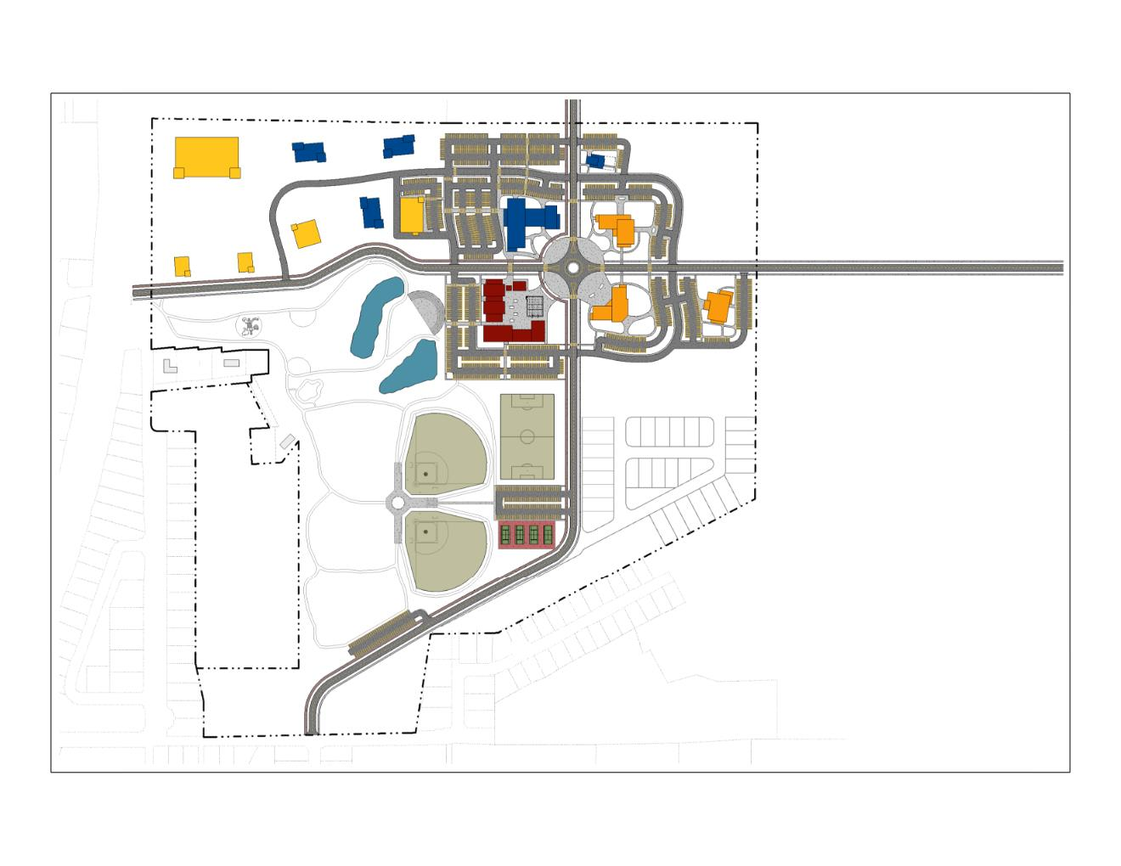
MASTER PLANNING PRESENTATION
Dos Lagos Master
Plan Amendment
PLANNING & PROGRAMMING– Site Planning
ARCHITECTURE
  Individual building
  Immediate site
  Planning
  Neighborhoods,
  municipalities
  regions
  Specialized
WHOLE BUILDING DESIGN
  Functional aspects
  Site conditions
  Natural environment
  Quality of life
  District relationships
  Building relationships
  Circulation
  Access

Slide 22
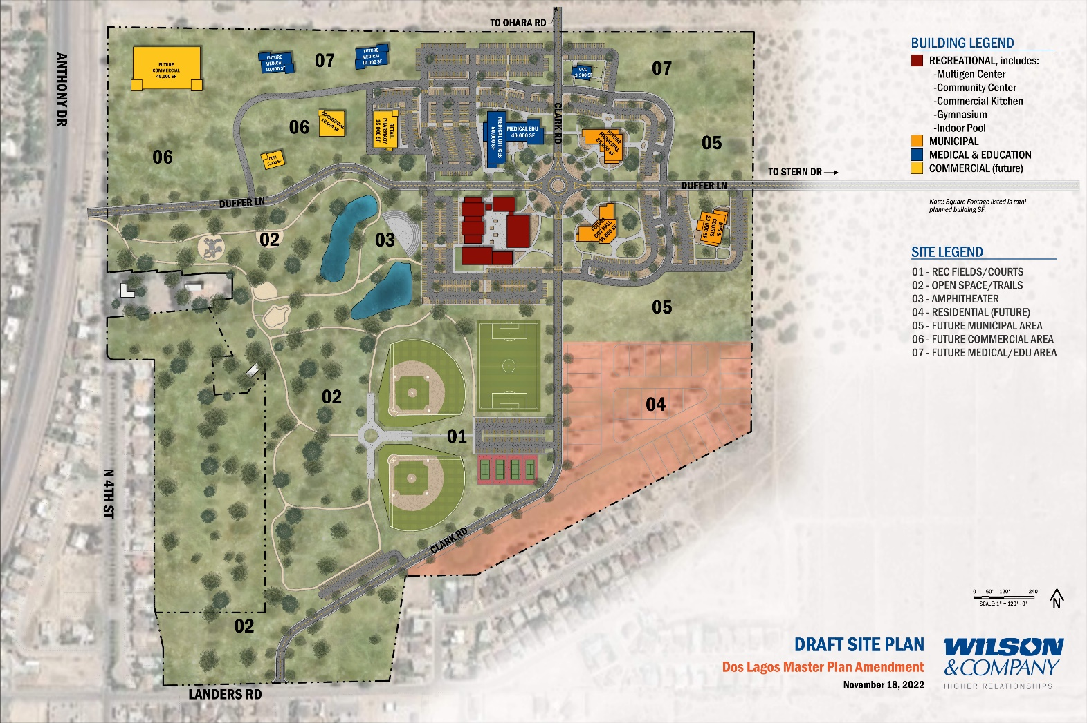
MASTER PLANNING PRESENTATION
Dos Lagos Master
Plan Amendment
PLANNING & PROGRAMMING– Site Planning
FOCUS ON HEALTH & WELLNESS
  Improving quality of life
  Providing missing services
OVERALL ORGANIZATION
  Duffer Ln & Clark Rd – Future extensions
    Access to site and areas
  Roundabout – Focal point of the site
  “Districts”
    Multigenerational (red)
    Municipal (orange)
    Medical & Education (blue)
    Proposed Commercial (yellow)
  Site Access
    Parking Strategies
ACTIVITIES & FEATURES
  Sport fields & courts
  Amphitheater
  Open space & trails
  Playgrounds
  Public plazas
  Landscaped areas

Slide 23
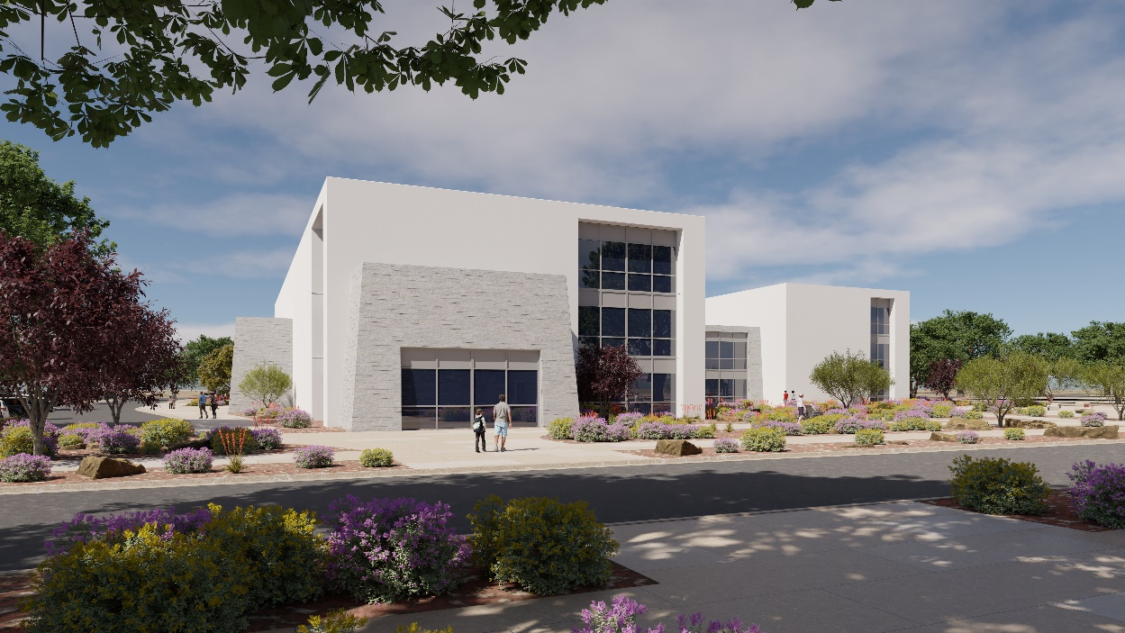
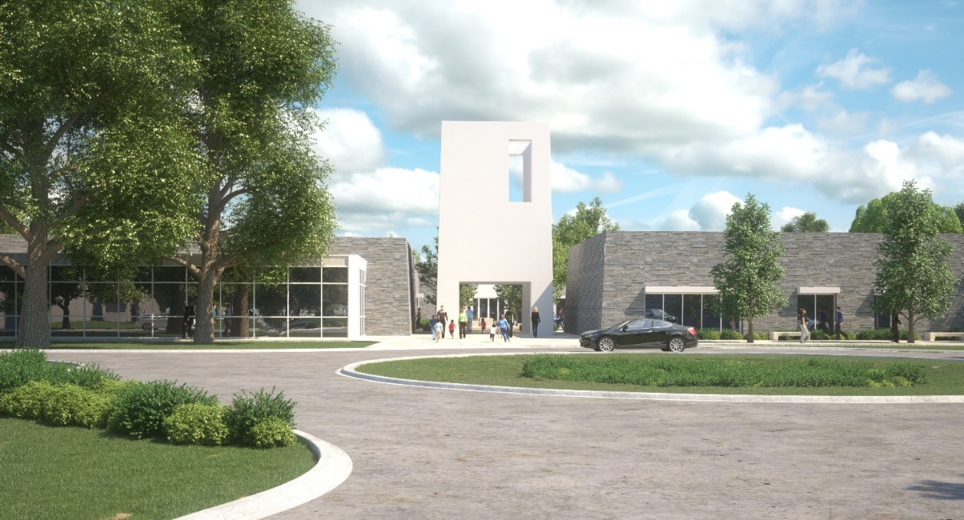
MASTER PLANNING PRESENTATION
Dos Lagos Master
Plan Amendment
PLANNING & PROGRAMMING– Site Planning
AESTHETICS
  Form and Image
    Creating a Destination in the City of Anthony
  Branding
    Developing an Identity for the Dos Lagos site
    Relationships between the different districts
    Incorporating landscaping and pedestrian access

Slide 24
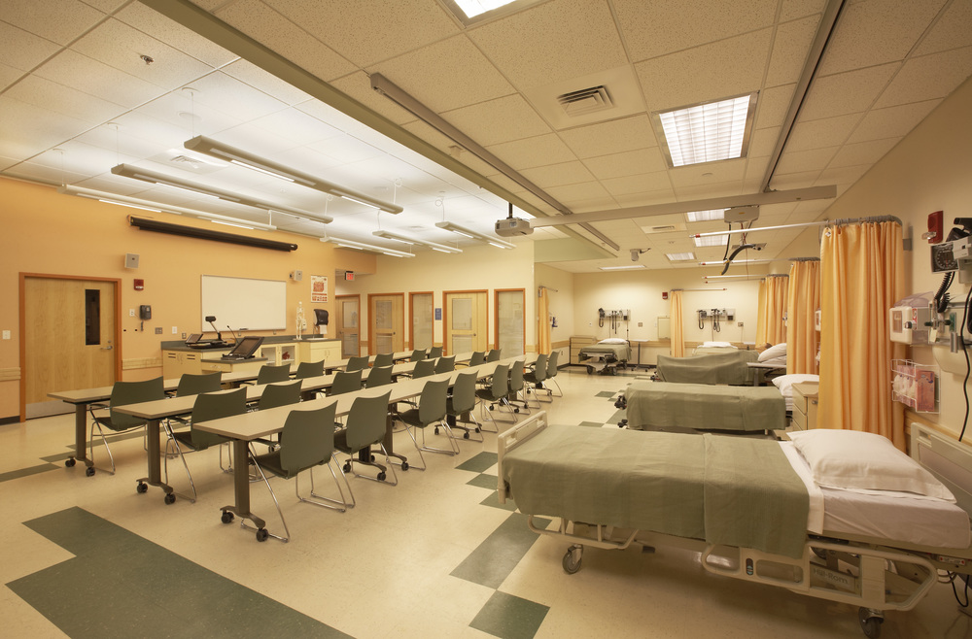
MASTER PLANNING PRESENTATION
Dos Lagos Master
Plan Amendment
PLANNING & PROGRAMMING– Programming
  TEACHING CLINIC
  Urgent Care (separate project)
  Primary Care
  Diagnostic imaging
  Diabetes Clinic
  Occupational Health & Speech Therapies
  Infusion services
  Cardiac Rehab
  Anticoagulation
  Rotating Specialties spaces

Slide 25
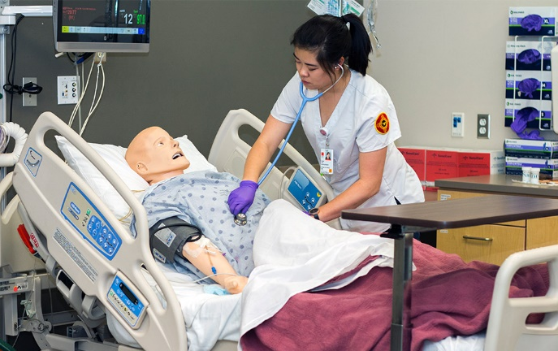
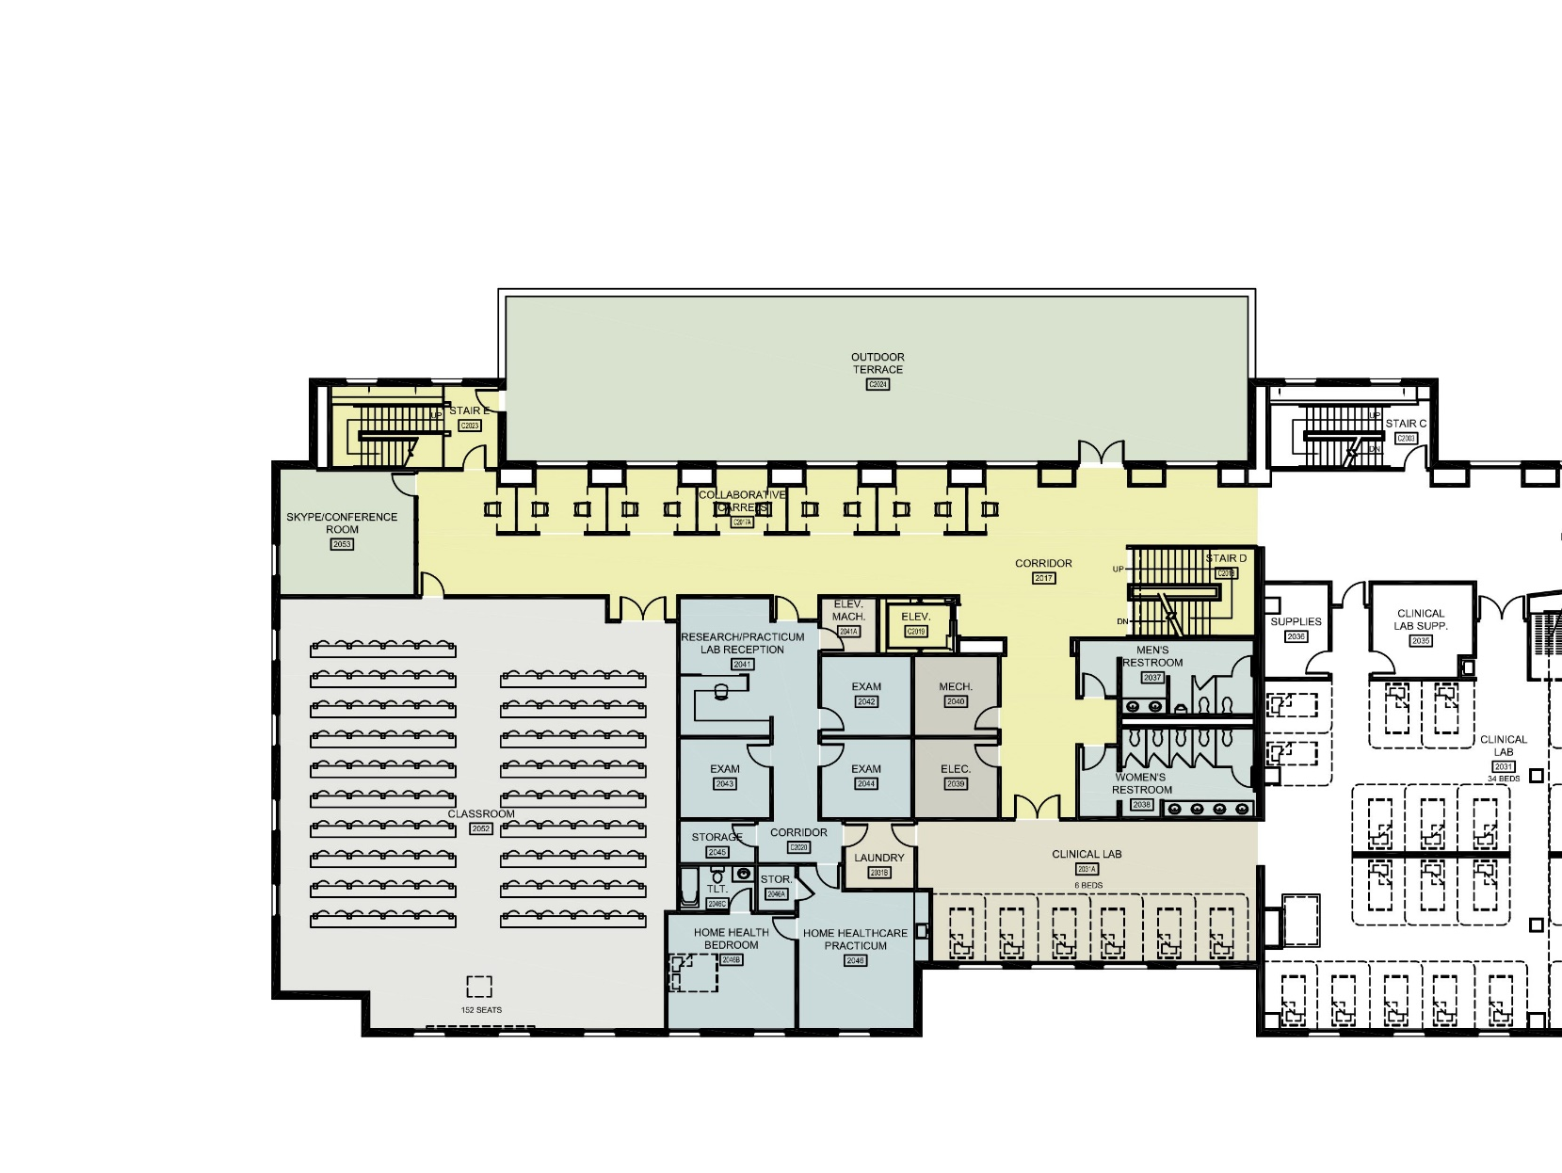
MASTER PLANNING PRESENTATION
Dos Lagos Master
Plan Amendment
PLANNING & PROGRAMMING– Programming
EDUCATIONAL PROGRAMS
  DACC
    Allied Healthcare Assistant
    Diagnostic Medical Sonography
    Emergency Medical Service/Tech (EMS & EMT)
    Nursing
    Radiologic Technology
    Respiratory Therapy
    General Education
    Common Spaces
  GADSEN ISD
    Biomedical Science
    Medical Intervention
    Medical Anatomy, Physiology & Terminology
    Healthcare Sciences & Occupations
    Safety & First Aid
    Electronic Health Records & Management
    Medical Office Procedures & Billing
    Legal & Ethical Healthcare

Slide 26
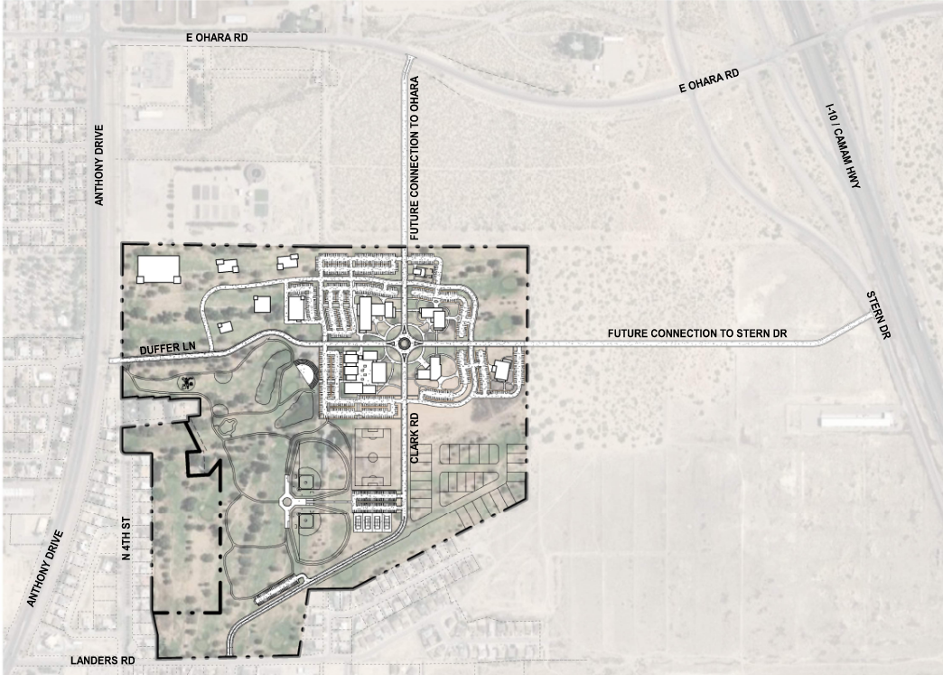
Dos Lagos Master
Plan Amendment
MASTER PLANNING PRESENTATION
INFRASTRUCTURE– Access
Main Access to Dos Lagos Property
Duffer Ln.
Clark Rd.
NMDOT (State Access Management Manual, NMDOT 2001)
Ohara Rd. Principal Arterial
Stern Dr. Minor Collector
 | Intersection | to | Intersection | Distance (feet) | Distance Needed (feet)
Landers Rd. | 4th Street |  | Clark Rd. | 700 | >300(unsignalized full access)
 | Clark Rd. |  | Sita Way | 600 | >300(unsignalized full access)
 | Intersection | to | Intersection | Distance (feet) | Distance Needed (feet)
Ohara Rd. | 4th Street |  | Clark Rd. | 1629 | >1320(unsignalized full access)
 | Clark Rd. |  | Stern Dr. | 2060 | >1320(unsignalized full access)
Stern Dr. | Stern Dr. |  | Duffer Ln. | 2274 | >660
 | Duffer Ln. |  | Acosta Rd. | 3389 | >660
Access Category | Posted Speed (mph) | Intersection Spacing (feet)
 |  | Signalized | Unsignalized
 |  |  | Full Access | Partial Access
Urban Principal Arterial (UPA) (Ohara Rd.) | 40 | 2640(0.5 mi) | 1320(0.25 mi) | 325
Urban Minor Collector (Urban Collector Highways, UCOL) (Stern Dr.) | 45 | 1743(0.33mi) | 660 | 350
Urban Collector (Landers Rd.) | <30 mph | 1100(0.2mi) | 330 | 150
  The access roadway traveling north connecting to NM 404 (Ohara Road) and Duffer Ln connecting to Stern Dr. was not assessed at this time since the property currently is not owned nor maintained by the City of Anthony, New Mexico.

Slide 27
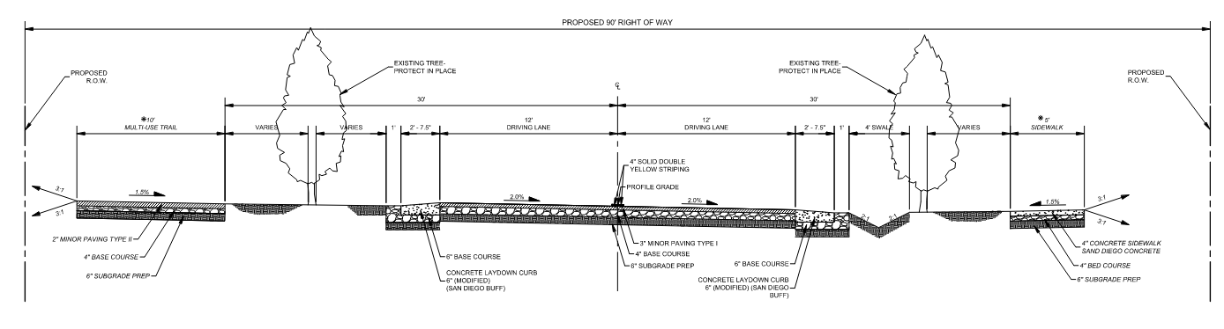
MASTER PLANNING PRESENTATION
Dos Lagos Master
Plan Amendment
INFRASTRUCTURE– Duffer Lane
Duffer Lane is an existing and Currently the only entrance to Dos Lagos Property
Improvements to Duffer lane is currently under 95% design
Improvements include:
two 12-ft driving lanes with concrete laydown curbs on each side,
A proposed swale,
A 10-ft multi-use path
A 5’ wide sidewalk
Roundabout located at the intersection of Clark Rd and Duffer Lane, making Clark Road a main internal road
  due to its slower speed, the roundabout will make it safer for pedestrians and cyclists

Slide 28
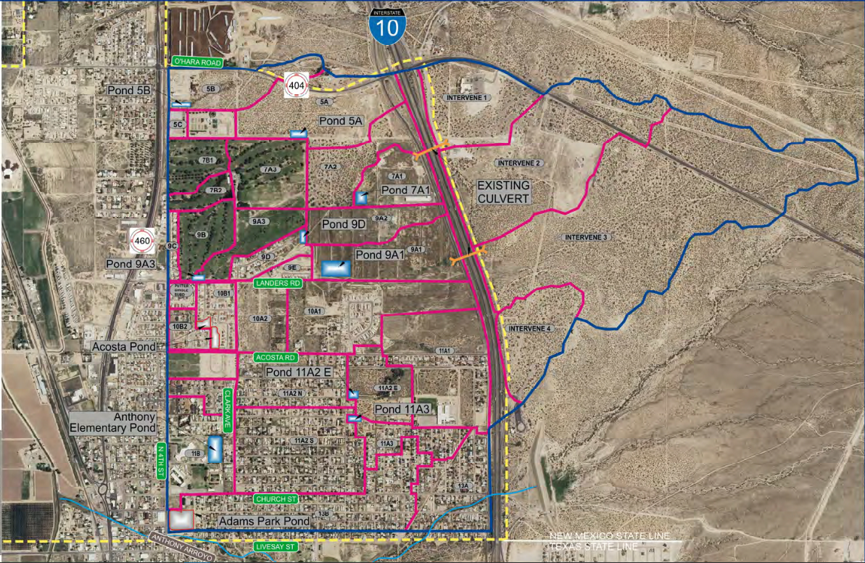
MASTER PLANNING PRESENTATION
Dos Lagos Master
Plan Amendment
INFRASTRUCTURE– Drainage
“City of Anthony Drainage Master Plan”
  Dated June 2017
  Wilson & Company, Inc., Engineers & Architects
  Recommendation:
  Retention pond 5A, Runoff from basin area 5A are currently going to Dos Lagos,
  Runoff from Basin 7A2, 7A3 and 9A3 are being recommended to go to retention pond 9A3
  Basins 7B1, 7B2 and 9B are currently going to existing storm drain system located at 4th street. Storm Drain System is currently going to Acosta Pond.

Slide 29
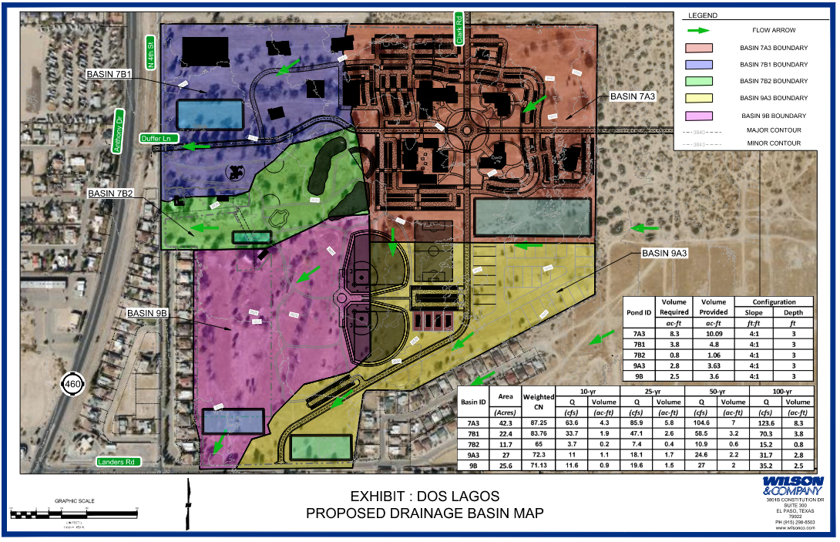
MASTER PLANNING PRESENTATION
Dos Lagos Master
Plan Amendment
INFRASTRUCTURE– Drainage
  City of Anthony Drainage Master Plan:
  CR-1 Community Residential: Single-Family Residential
  Dos Lagos Master Plan:
  Commercial and business
  New development will not affect the capacity of Existing Acosta Pond and will continue to follow the City of Anthony Drainage Master plan

Slide 30
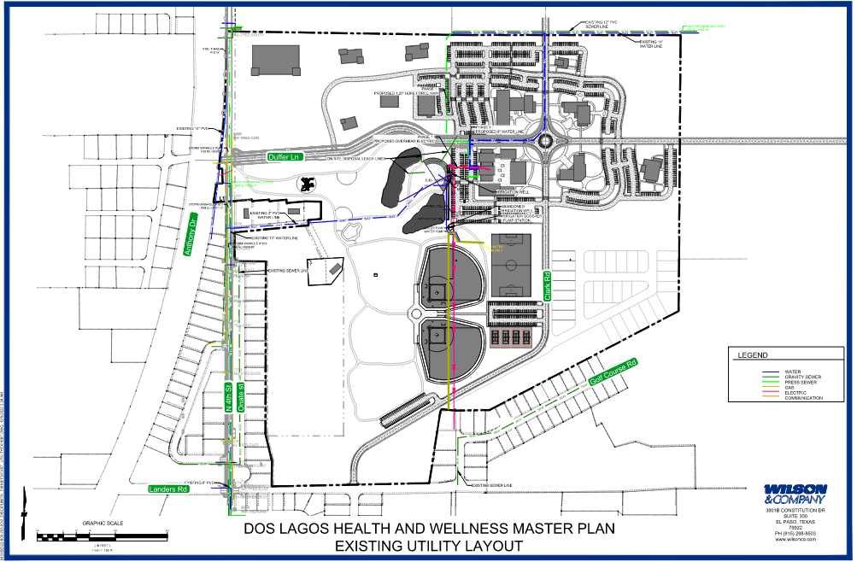
MASTER PLANNING PRESENTATION
Dos Lagos Master
Plan Amendment
INFRASTRUCTURE– Utilities
Existing utilities within the project corridor of Anthony, NM have been identified to include:
El Paso Electric - overhead electric
NM Gas - underground gas
Anthony Water & Sanitation District - water and wastewater
Lumen – Telecommunication lines and fiber optics
Spectrum – IT/Broadband

Slide 31

MASTER PLANNING PRESENTATION
Dos Lagos Master
Plan Amendment
INFRASTRUCTURE– Utilities

Slide 32

END

Slide 33
OPEN DISCUSSION
QUESTIONS & COMMENTS

