Slide 1




EL PASO ELECTRIC (EPE)
The Benefits of Smart Meters in your Home
Grisel E. Ramirez, P.E.
Supervisor – Adavanced Metering and Analytics
August 1, 2023
Notes:
Introduction – talk about the project EPE is replacing its current meters with state-of-the-art smart meter technology
What is a smart meter is a digital meter that remotely tracks energy use in near real time and sends the data to EPE through a secure communication network.

Slide 2

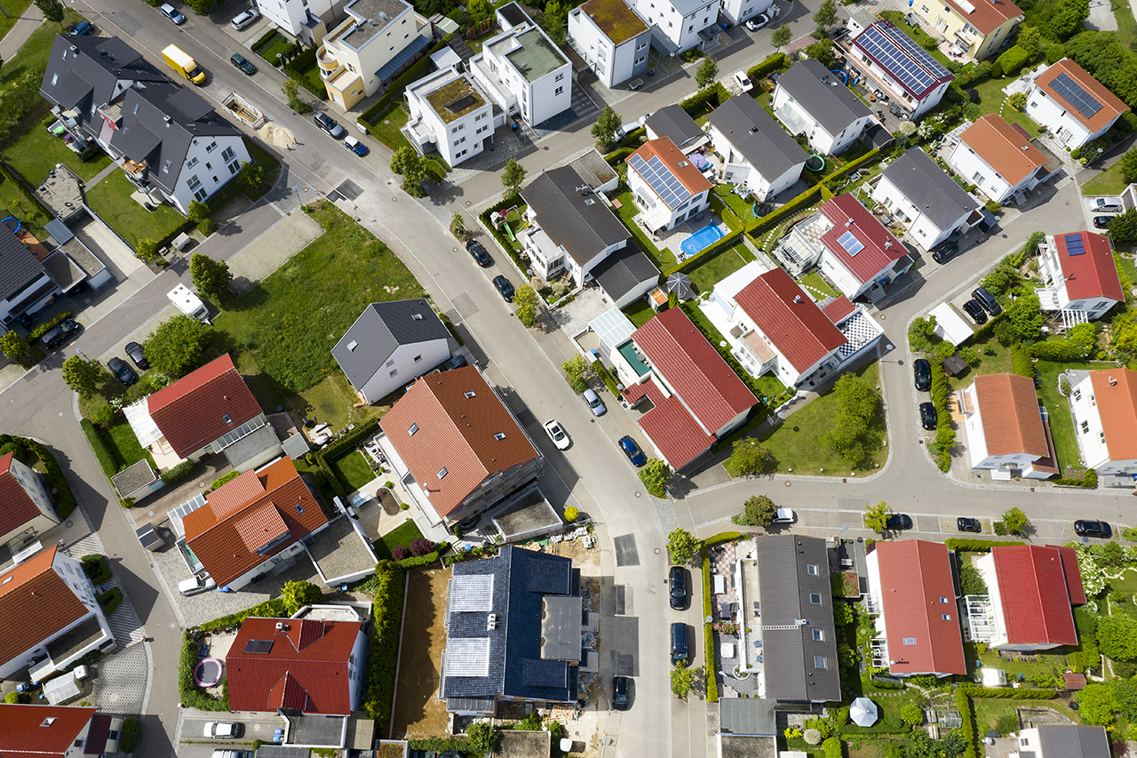

SMART METERS ADVANCE EPE’S MISSION
EPE is transforming the energy landscape, and this is a significant step in the transformation.
Smart meters will help EPE achieve its climate goals of becoming carbon neutral by 2035 and carbon free by 2045.
EPE’s strategic pillars:
  Build trusted partnerships
  Propel growth in our region
  Leverage technology
  Lead with environmental sustainability
  Drive a culture of empowerment
EPE Smart Meters 101

Slide 3

CUSTOMER BENEFITS
Improve outage management
More control over energy use
Maximize customer experience
Provide a wider range of program offerings
Enhance reliability and resiliency
EPE Smart Meters 101

Slide 4


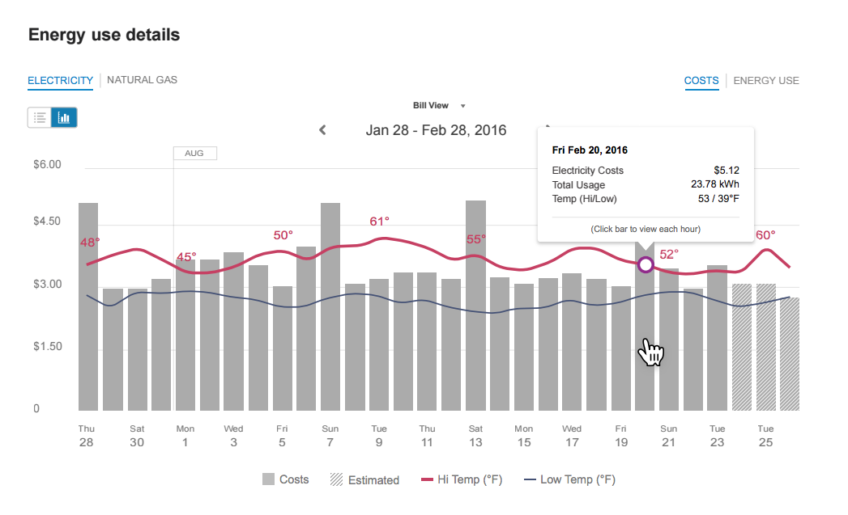
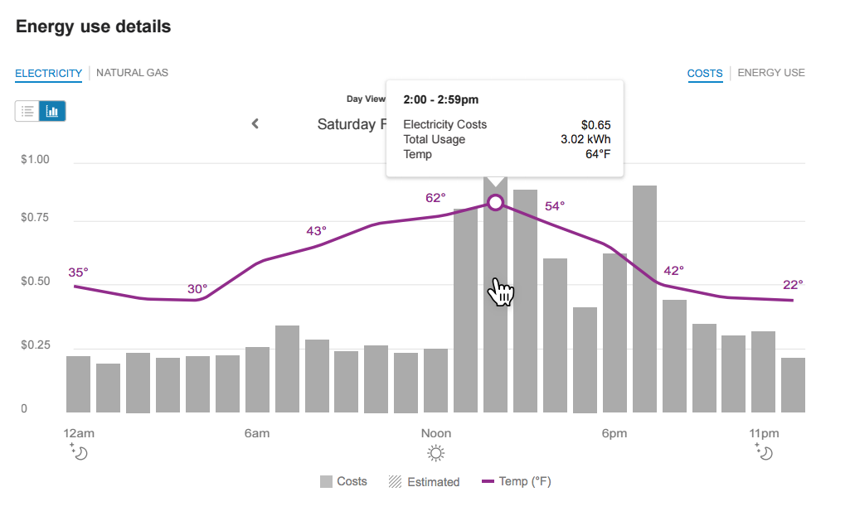
NOW, YOU’VE GOT THE POWER
The smart meters will provide energy consumption data in near real time so customers can track their energy use and make simple adjustments to save money and help the environment.
  Option to access energy data through online portal
  Option to receive customized energy saving tips, projected usage and bill alerts
  Capability to remotely modify service status and rates at request of the customer
EPE Smart Meters 101

Slide 5
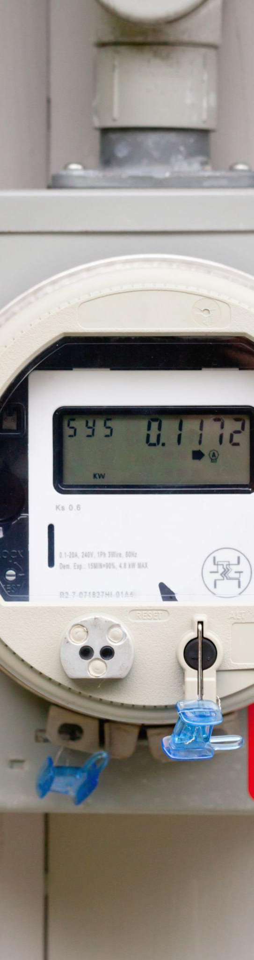
ADDRESSING CONCERNS
Smart meters provide detailed energy usage information for customers to assess and act on savings recommendations. They do not manage energy use or control thermostats.
EPE will not share customer data with third parties unless requested by the customer.
A surcharge or rider on the monthly electric bill helps cover the cost of smart meters.
Beware of scams: Installers will not request payment, personal information, or account details.
EPE Smart Meters 101
Notes:
1st Meter was installed on April 24, 2023 and mass deployment began on May 15, 2023.
Most residential customers will be able to see their energy use in 15-minute increments.

Slide 6
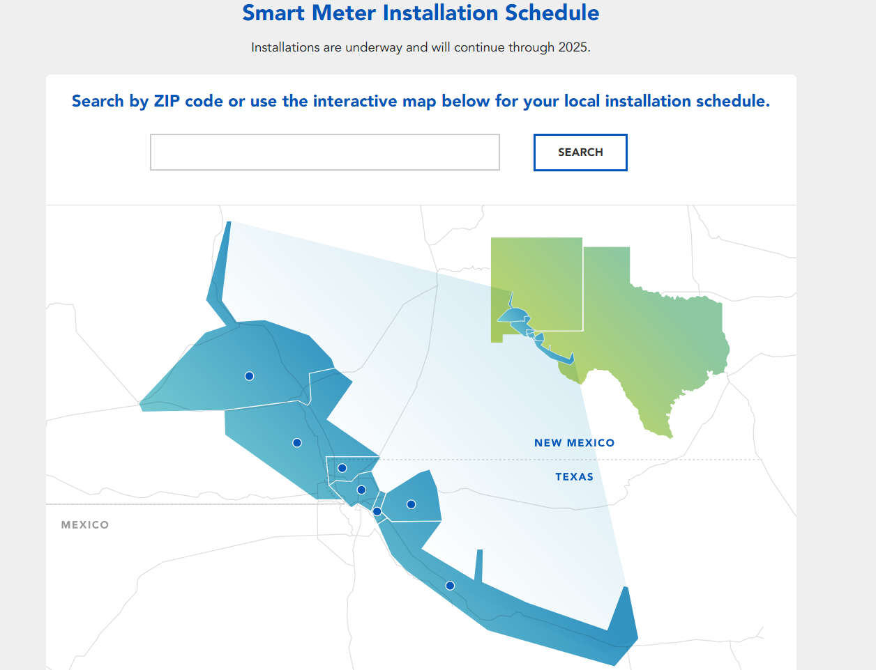
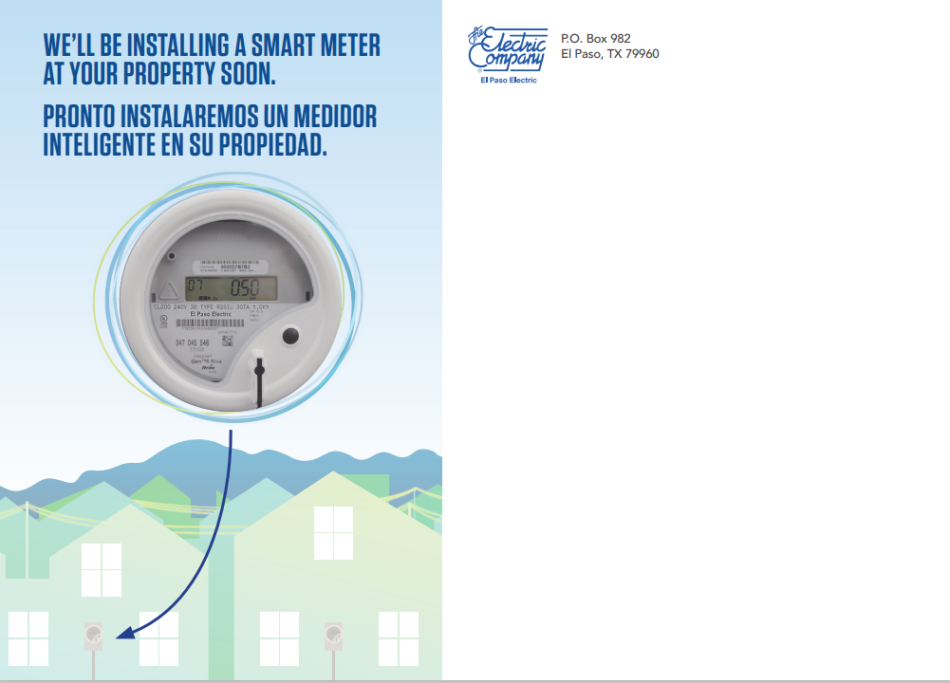
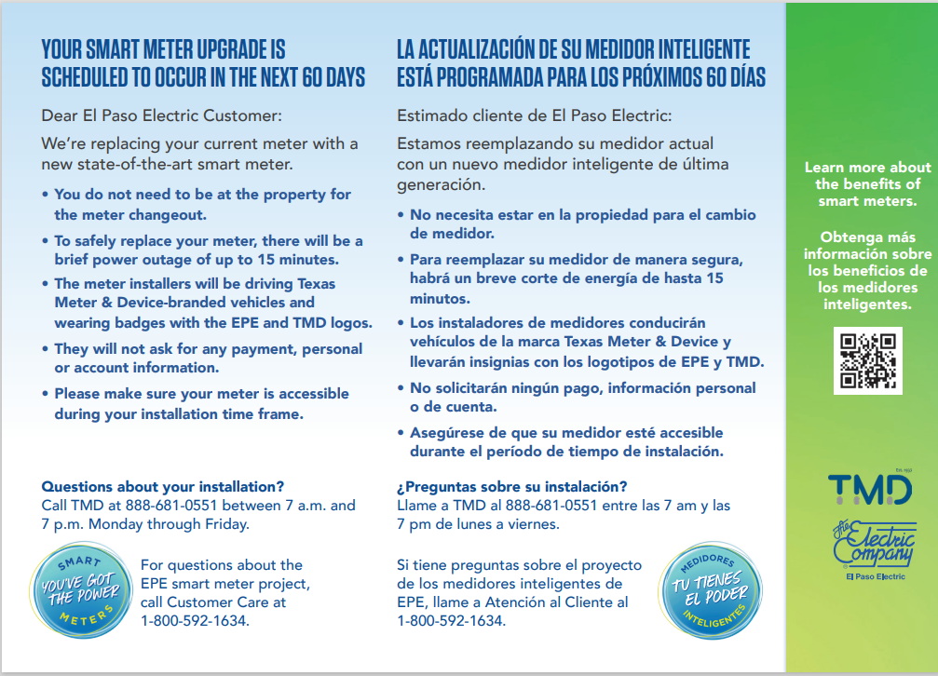
WHEN WILL MY SMART METER BE INSTALLED?
Take advantage of your new smart meter!
Create an online account with El Paso Electric. Visit Manage My Account at epelectric.com
Manage your account by downloading the EPE app in the Apple Store or Google Play.
https://www.epelectric.com/smartmeters
Notes:
New Mexico installations will begin in fall 2023.
Multi-year project with a projected end date of 2025.
Customers will receive a postcard in the mail 60 days prior to their scheduled installation date.
Customers do not need to be present for the meter changeout, and no appointment is needed except under special circumstances.
Installation will require power to be turned off for 5 to 15 minutes.

Slide 7
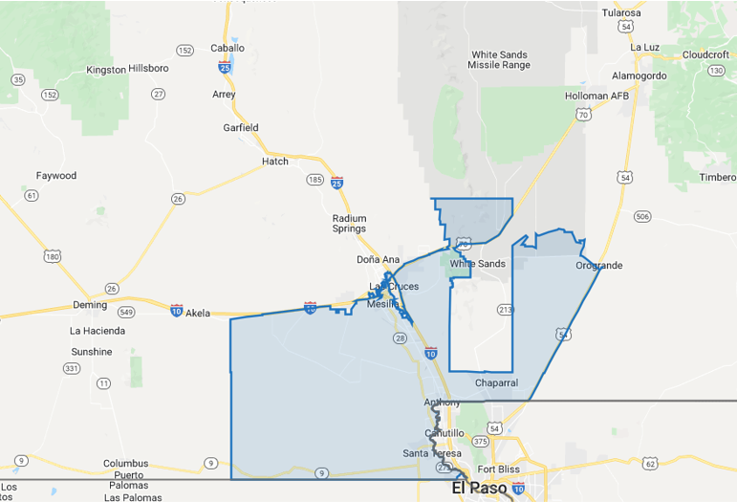
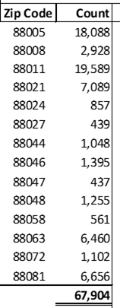
AMS Deployment - Optimization Area 6
September 2023 – June 2024

Slide 8
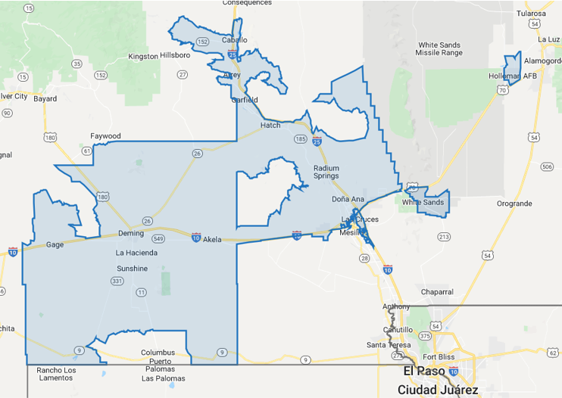
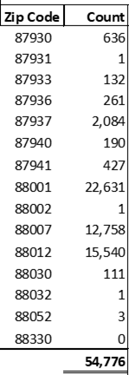
AMS Deployment - Optimization Area 7
May 2024 – February 2025

Slide 9


INSTALLATION PROCESS
Customers will receive mail notification 30-60 days prior to inform them about their upcoming installation
No customer presence or appointment required for meter changeout, except in special cases.
Ensure meter clearance before installation.
Installers → EPE contractors from Texas Meter & Device (TMD).
No payment or personal/account information will be requested.
Meter exchange will be done if accessible, leaving a door hanger.
Power will be turned off for 5 to 15 minutes.
Customers with special circumstances should contact EPE.
ENG: https://www.youtube.com/watch?v=8fpXU6eOaXA
SPN: https://www.youtube.com/watch?v=LS0kVZ98f4M
EPE Smart Meters 101
Notes:
Customers:
do not need to be present, and no appointment is needed except under special circumstances.
should ensure there is adequate clearance around their meter prior to their installation date.

Slide 10
Thank You!
Visit epelectric.com/smartmeters for more information.

Slide 11
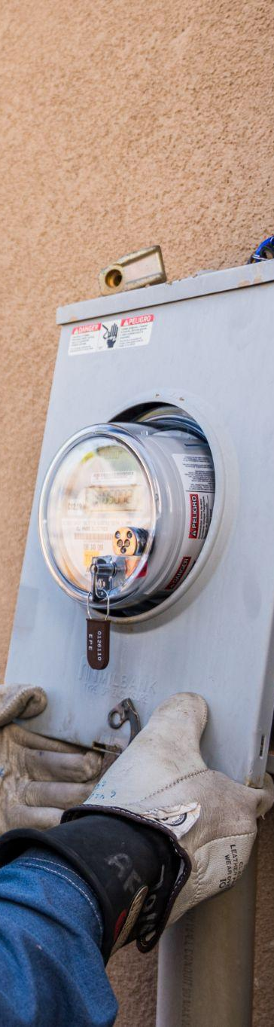
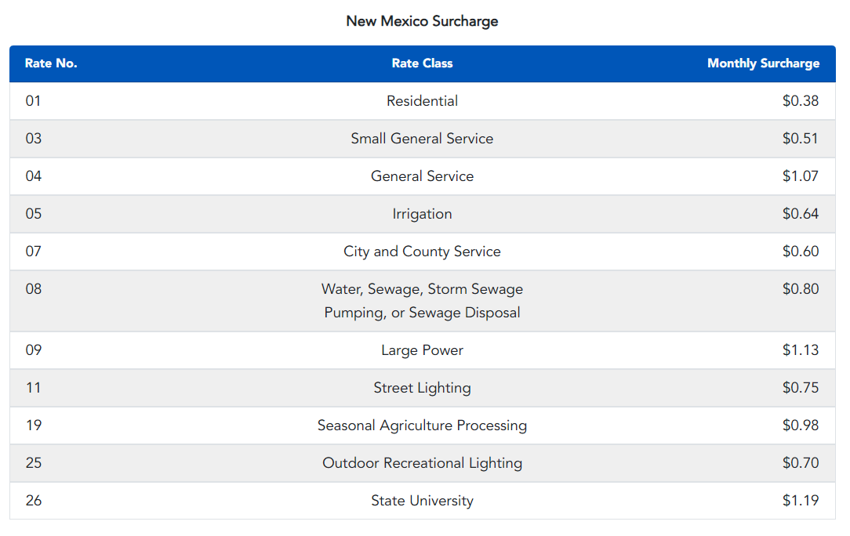
NM MONTHLY SURCHARGE
EPE Smart Meters 101

Slide 12
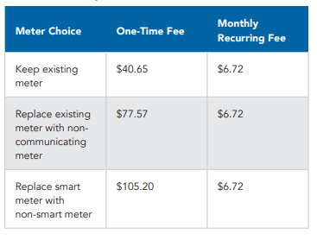
NM OPT FEES
EPE Smart Meters 101

